Slide 1
5.2 Bisectors of Triangles
Use the properties of perpendicular bisectors of a triangle
Use the properties of angle bisectors of a triangle

Slide 2
Definitions
A perpendicular bisector of a triangle is a line (or ray or segment) that is perpendicular to the side of a triangle at the midpoint of the side
Concurrent lines are 3 or more lines (rays or segments) that intersect at the same point
The Point of concurrency is the point of intersection.

Slide 3
In a triangle, the Point of Concurrency is called the Circumcenter of the triangle
The circumcenter can be located inside, on or outside the triangle.
It is called the circumcenter because it is the center of a circle that passes through all the vertices of the triangle

Slide 4
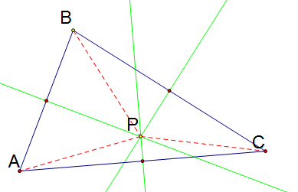
Theorem 5.5 - Concurrency of Perpendicular Bisectors of a Triangle
The Perpendicular Bisectors of a triangle intersect at a point that is equidistant from the vertices of a triangle. (PA = PB = PC)

Slide 5
Definitions
An Angle Bisector of a Triangle is a bisector of an angle of a triangle
The Incenter of the Triangle is the point of concurrency of the angle bisectors
The Incenter always lies inside the triangle.

Slide 6
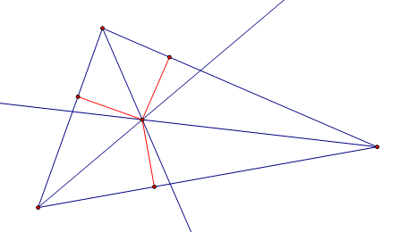
Theorem 5.6 (Concurrency of Angle Bisectors of a Triangle):
The angle bisectors of a triangle intersect at a point that is equidistant from the sides of the triangle.

