Slide 1
Standard G-3
Objectives:
Do an activity to prove that the sum of the measures of three angles in a triangle is 180
We will do practice problems in the workbook.

Slide 2
Key words
Triangle
Interior angles
Degree
Complete angle
Straight angle
Missing angle

Slide 3
Definition
Degree – a unit of measurement of an angle or arc, represented by the symbol º.
30º

Slide 4
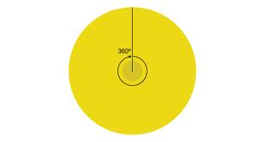
Degree
360th part of a complete angle is called degree.

Slide 5
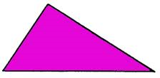
Definition
Triangle – a polygon bounded by three line segments. It has three angles.

Slide 6
Property of triangles
The sum of all the angles equals 180º degrees.
60º
90º
30º

Slide 7
Property of triangles
The sum of all the angles equals 180º degrees.
40º
90º
40º
50º
+
180º
90º
50º

Slide 8
Property of triangles
The sum of all the angles equals 180º degrees.
60º
60º
60º
60º
+
180º
60º
60º

Slide 9
What is the missing angle?
70º
70º
?
?
+
180º
70º
70º

Slide 10
What is the missing angle?
90º
30º
?
?
+
30º
90º
180º

Slide 11
What is the missing angle?
30º
?
78º
?
78º
30º
+
180º

Slide 12
What is the missing angle?
40º
?
40º
?
40º
40º
+
180º

Slide 13
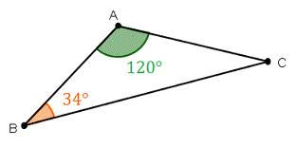
What is the missing angle?

Slide 14
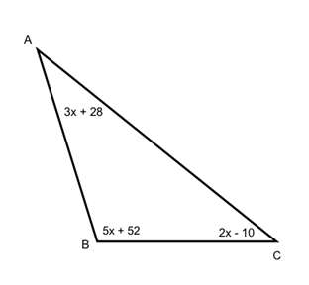
Find all three angles of triangle

Slide 15
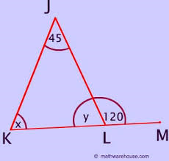
H.O.T.
Find x, y values.

Slide 16
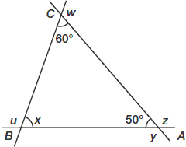
Let us find out all unknown angles.

Slide 17
What Is the Sum of My Angles?

Slide 18
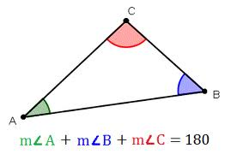
sum of three angles in a triangle
Activity: Steps:
Draw a triangle on a piece of paper using a ruler
Mark the angles of triangle
Cut out the triangle
Cut out the three angles of triangle
Place the angles along a straight line
Conclude the sum of three angles is 180 degrees.

Slide 19
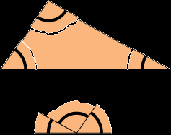
Model

Slide 20
Practice work
We will do the practice problems in the workbook

