Slide 1
Basic Terminologies in Statistics

Slide 2
Anticipatory Set:
What is statistics?

Slide 3
Standards:

Slide 4
Objectives: The students will be able to
Identify variables in a statistical study.
Distinguish between quantitative and qualitative variables.
Identify populations and samples.
Determine the level of measurement.

Slide 5
What to learn
Definition of statistics.
Definitions of individual and variable.
Difference between quantitative variable and qualitative variable.
Difference between population data and sample data.
Levels of measurement

Slide 6
A. Statistics
Statistics is the study of how to;
Collect,
Organize,
Analyze, and
Interpret
numerical information from data.

Slide 7
B. Individual
Individuals are the people or objects included in the study.
Example :
If we want to do a study about the people who have climbed Mt. Everest, then the individuals in the study are all people who have actually made it to the summit.

Slide 8
C. Variable
A variable is the characteristic of the individual to be measured or observed.
Example:
One variable might be the height of the individual who climbed Mt. Everest. Other variables might be age, weight, gender, nationality, income.

Slide 9
D. Types of variable
Quantitative Variable
It has a value or numerical measurement for which operations such as addition or averaging make sense.
Example: For the Mt. Everest climbers, variables such as (a) height, (b) weight, (c) age, and (d) income are quantitative.
Qualitative Variable
It describes an individual by placing the individual into a category or group.
Example: For the Mt. Everest climbers, variables such as (a) gender and (b) nationality are qualitative.

Slide 10
E. Population Data
The population can be thought of as measurements or observations for the entire group of objects or individuals about which information is desired.
Examples:
The data from all the individuals who have climbed Mt. Everest.
The ages of all U.S. presidents at the time of inauguration from George Washington to Barack Obama.

Slide 11
F. Sample Data
The sample data are measurements or observations from only some of the individuals of interest.

Slide 12
G. Guided Exercises
Television station ABC wants to know the proportion of TV owners in South Carolina who watch the station’s new program at least once a week. The station asked a group of 1000 TV owners in South Carolina if they watch the program at least once a week.
The individuals are the 1000 TV owners surveyed.
The variable is the response, does or does not watch the program once a week.
a. Identify the individuals of
the study and the variable.
b. Do the data comprise the sample or population?
The data comprise the sample
Qualitative – the categories are the two possible responses, does or does not watch the program.
c. Is the variable quantitative or qualitative?

Slide 13
G. Guided Exercises
2. USA Today reported that 44. 9% of those surveyed (1261 adults) ate in fast-food restaurants from one to three times a week
The variable is the response regarding frequency of eating at fast-food restaurants.
a. Identify the variable.
b. Is the variable quantitative or qualitative?
Qualitative
Responses for all adults in the U.S.
c. What is the implied population?

Slide 14
G. Guided Exercises
3. The students at Eastmore College are concerned about the level of student fees. They took a random sample of 30 colleges and universities throughout the nation and obtained information about the student fees at these institutions. From these information they concluded that their student fees are higher than those of most colleges in the nation.
a. Identify the variable.
Student Fees
b. Is the variable quantitative or qualitative?
Quantitative
Student fees at all colleges and universities in the U.S.
c. What is the implied population?

Slide 15
G. Guided Exercises
4. An insurance company wants to determine the time intterval between the arrival of an insurance payment check and the time that the check clears. A central payment office processes the payments for a five-state region. A random sample of 32 payment checks from this five-state region was received and processed. The time interval between receipt and check clearance was determined for each check. From these information the company estimated the time interval necessary for all checks sent to this office to clear.
a. Identify the variable.
Time interval between check arrival and clearance.
b. Is the variable quantitative or qualitative?
Quantitative
Time interval between check arrival and clearance of all checks from offices in the five-state region.
c. What is the implied population?

Slide 16
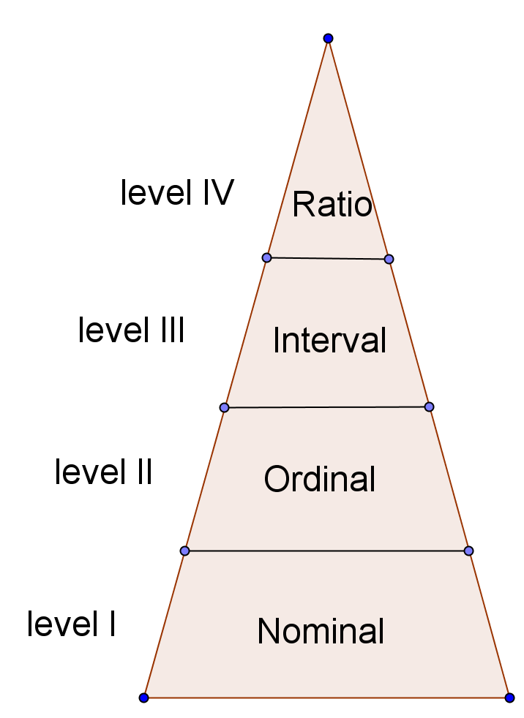
H. Levels of Measurement
It is like the interval level, but it includes an inherent zero as a starting point of all measurements.
It is like the ordinal level, but it has the additional property that meaningful differences between data values can be computed.
Data at this level may be arrange in some order.
“Name Only”. Data at this level of measurement consists of “names only” or qualities.

Slide 17
Level I: Nominal
We can put the data into categories.
Level II: Ordinal
We can order the data from smallest to largest or from worst to best. Each data value can be compared with another data value.
Level III: Interval
We can order the data and also take the differences between data values. At this level, it makes sense to compare the differences between data values. For instance, we can say that one data value is 5 more than the other or we can say 12 less than another data value.
Level IV: Ratio
We can order the data, take differences, and also find the ratio between data values. For instance, it makes sense to say that one data value is twice as large as another.

Slide 18
Guided Practice:
1. The following describe different data associated with a state senator. For each data entry, indicate the corresponding level of measurement.
a. The senator’s name is Sam Wilson
Nominal level
b. The senator is 58 years old.
Ratio level
c. The years in which the senator was elected to the senate are 1980, 1986, 1992, & 1998.
Interval level
d. His total taxable income last year was $878,314.19
Ratio level

Slide 19
e. The senator sponsored a bill to protect water rights. Out of 1100 voters in his district 400 said they strongly favored the bill, 300 said they favored the bill, 200 said they were neutral, 150 said they did not favor the bill, and 50 said they strongly did not favor the bill.
Ordinal level
f. The senator is married now
Nominal level
g. A leading news magazine claims the senator is ranked seventh for his record on bills regarding public education.
Ordinal level

Slide 20
Guided Practice:
2. Categorize the measurements associated with student life according to level: nominal, ordinal, interval, or ratio.
a. Length of time to complete an exam.
Ratio level
b. Time of first class.
Interval level
c. Major field of study.
Nominal level
Interval level
d. Course evaluation scale: poor, acceptable, good
Ratio level
e. Score on last exam (Based on 100 possible points)
f. Age of student
Ratio level

Slide 21
Independent Practice: Do # 2, 4, 6, 8 on pages 10 – 11.

